Slide 1
Chapter 5: Advanced SQL

Slide 2
Outline
Accessing SQL From a Programming Language
Functions and Procedures
Triggers
Recursive Queries
Advanced Aggregation Features

Slide 3
Accessing SQL from a Programming Language
A database programmer must have access to a general-purpose programming language for at least two reasons
Not all queries can be expressed in SQL, since SQL does not provide the full expressive power of a general-purpose language.
Non-declarative actions -- such as printing a report, interacting with a user, or sending the results of a query to a graphical user interface -- cannot be done from within SQL.

Slide 4
Accessing SQL from a Programming Language (Cont.)
There are two approaches to accessing SQL from a general-purpose programming language
A general-purpose program -- can connect to and communicate with a database server using a collection of functions.
The dynamic SQL component of SQL allows programs to construct and submit SQL queries at runtime.
Enables flexible applications.
less efficient since access plans for dynamic statements are generated at run-time. (even if they are created using the prepared statement feature).
More security risks.
Embedded SQL (static) -- provides a means by which a program can interact with a database server.
The SQL statements are translated at compile time into function calls.
At runtime, these function calls connect to the database using an API that provides dynamic SQL facilities.
Cannot change at run-time. Less flexible. Hard to debug..
More efficient execution.
More secure

Slide 5
JDBC

Slide 6
JDBC
JDBC is a Java API for communicating with database systems supporting SQL.
JDBC supports a variety of features for querying and updating data, and for retrieving query results.
JDBC also supports metadata retrieval, such as querying about relations present in the database and the names and types of relation attributes.
Model for communicating with the database:
Open a connection
Create a “statement” object
Execute queries using the statement object to send queries and fetch results
Exception mechanism to handle errors

Slide 7
JDBC Code
public static void JDBCexample(String dbid, String userid, String passwd)
{
try (Connection conn = DriverManager.getConnection( "jdbc:oracle:thin:@db.yale.edu:2000:univdb", userid, passwd);
Statement stmt = conn.createStatement(); )
{
… Do Actual Work ….
}
catch (SQLException sqle) {
System.out.println("SQLException : " + sqle);
}
}
NOTE: Above syntax works with Java 7, and JDBC 4 onwards. Resources opened in “try (….)” syntax (“try with resources”) are automatically closed at the end of the try block

Slide 8
JDBC Code for Older Versions of Java/JDBC
public static void JDBCexample(String dbid, String userid, String passwd)
{
try {
Class.forName ("oracle.jdbc.driver.OracleDriver");
Connection conn = DriverManager.getConnection( "jdbc:oracle:thin:@db.yale.edu:2000:univdb", userid, passwd);
Statement stmt = conn.createStatement();
… Do Actual Work ….
stmt.close();
conn.close();
}
catch (SQLException sqle) {
System.out.println("SQLException : " + sqle);
}
} NOTE: Class.forName is not required from JDBC 4 onwards. The try with resources syntax in prev slide is preferred for Java 7 onwards.

Slide 9
JDBC Code (Cont.)
Update to database
try { stmt.executeUpdate( "insert into instructor values('77987', 'Kim', 'Physics', 98000)"); } catch (SQLException sqle) { System.out.println("Could not insert tuple. " + sqle); }
Execute query and fetch and print results
ResultSet rset = stmt.executeQuery( "select dept_name, avg (salary) from instructor group by dept_name"); while (rset.next()) { System.out.println(rset.getString("dept_name") + " " + rset.getFloat(2)); }

Slide 10
JDBC SUBSECTIONS
Connecting to the Database
Shipping SQL Statements to the Database System
Exceptions and Resource Management
Retrieving the Result of a Query
Prepared Statements
Callable Statements
Metadata Features
Other Features
Database Access from Python

Slide 11
JDBC Code Details
Getting result fields:
rs.getString(“dept_name”) and rs.getString(1) equivalent if dept_name is the first argument of select result.
Dealing with Null values
int a = rs.getInt(“a”);
if (rs.wasNull()) Systems.out.println(“Got null value”);

Slide 12
Prepared Statement
some values are replaced by “?”, actual values will be provided later. The database system compiles the query when it is prepared.
Primary advantage:: Compile one, execute multiple times with different input parameters
PreparedStatement pStmt = conn.prepareStatement( "insert into instructor values(?,?,?,?)");
// No execution yet..Only generate access plan. pStmt.setString(1, "88877"); pStmt.setString(2, "Perry"); pStmt.setString(3, "Finance"); pStmt.setInt(4, 125000); pStmt.executeUpdate(); pStmt.setString(1, "88878"); pStmt.executeUpdate(); // execute !!
WARNING: always use prepared statements when taking an input from the user and adding it to a query
NEVER create a query by concatenating strings
"insert into instructor values(' " + ID + " ', ' " + name + " ', " + " ' + dept name + " ', " ' balance + ')“
What if name is “D'Souza”? ==> Need prepared statement!!

Slide 13
SQL Injection
Even Compile one, execute only 1 time. ==> use prepared statement for security!!
Suppose query is constructed using
"select * from instructor where name = '" + name + "'"
Suppose the user, instead of entering a name, enters:
X' or 'Y' = 'Y
then the resulting statement becomes:
"select * from instructor where name = '" + "X' or 'Y' = 'Y" + "'"
which is:
select * from instructor where name = 'X' or 'Y' = 'Y'
User could have even used
X'; update instructor set salary = salary + 10000; -- + name + "'"
Prepared stament internally uses: "select * from instructor where name = 'X\' or \'Y\' = \'Y' 'Y' = 'Y false!
Always use prepared statements, with user inputs as parameters.
there have been a number of attacks in the real world using SQL injections; attacks on multiple financial sites have resulted in theft of large amounts of money by using SQL injection attacks.!!
Application!!
Inject another SQL!!
Notes:
"select * from instructor where name = ‘ " + name + " ‘ "
Prepared statement setString ve benzeri fonksiyonlar input içindeki ‘ leri escape ile tutuyor. Böylece \'Y\' = \'Y TRUE olmuyor.
Some database systems allow multiple SQL statements to be executed in a single JDBC execute method, with statements separated by a semicolon. This feature has
been turned off by default on some JDBC drivers because it allows malicious hackers to insert whole SQL statements using SQL injection.

Slide 14
Metadata Features
ResultSet metadata::: the number of columns in the result, the name of a specified column, or the type of a specified column.
E.g.after executing query to get a ResultSet rs:
ResultSetMetaData rsmd = rs.getMetaData();
for(int i = 1; i <= rsmd.getColumnCount(); i++) {
System.out.println(rsmd.getColumnName(i));
System.out.println(rsmd.getColumnTypeName(i));
}
How is this useful?
Enable to application more generic, search all cases..
code can work regardless of the actual query submitted.

Slide 15
Metadata (Cont)
Database metadata
DatabaseMetaData dbmd = conn.getMetaData();
// Arguments to getColumns: Catalog, Schema-pattern, Table-pattern, // and Column-Pattern // Returns: One row for each column; row has a number of attributes // such as COLUMN_NAME, TYPE_NAME // The value null indicates all Catalogs/Schemas. // The value “” indicates current catalog/schema // The value “%” has the same meaning as all names
ResultSet rs = dbmd.getColumns(null, "univdb", "department", "%");
while( rs.next()) {
System.out.println(rs.getString("COLUMN_NAME"),
rs.getString("TYPE_NAME");
}
And where is this useful?

Slide 16
Metadata (Cont)
Database metadata
DatabaseMetaData dbmd = conn.getMetaData();
// Arguments to getTables: Catalog, Schema-pattern, Table-pattern, // and Table-Type // Returns: One row for each table; row has a number of attributes // such as TABLE_NAME, TABLE_CAT, TABLE_TYPE, .. // The value null indicates all Catalogs/Schemas. // The value “” indicates current catalog/schema // The value “%” has the same meaning as SQL like clause // The last attribute is an array of types of tables to return. // TABLE means only regular tables
ResultSet rs = dbmd.getTables (“”, "", “%", new String[] {“TABLES”});
while( rs.next()) {
System.out.println(rs.getString(“TABLE_NAME“));
}
And where is this useful?
The metadata information can be used to make code used for applications generic:
Notes:
they can be used to write a database browser that allows a user to find the tables in a database, examine their schema, examine rows in a table, apply selections to see desired rows, and so on. The metadata information can be used to make code used for these tasks
generic;

Slide 17
Finding Primary Keys
DatabaseMetaData dmd = connection.getMetaData(); // Arguments below are: Catalog, Schema, and Table // The value “” for Catalog/Schema indicates current catalog/schema // The value null indicates all catalogs/schemas ResultSet rs = dmd.getPrimaryKeys(“”, “”, tableName); while(rs.next()){ // KEY_SEQ indicates the position of the attribute in // the primary key, which is required if a primary key has multiple // attributes System.out.println(rs.getString(“KEY_SEQ”), rs.getString("COLUMN_NAME"); }

Slide 18
Transaction Control in JDBC
By default, each SQL statement is treated as a separate transaction that is committed automatically
bad idea for transactions with multiple updates ?? Why bad idea??
Can turn off automatic commit on a connection
conn.setAutoCommit(false);
Transactions must then be committed or rolled back explicitly
conn.commit(); or
conn.rollback();
conn.setAutoCommit(true) turns on automatic commit.

Slide 19
Other JDBC Features
Calling functions and procedures:: the same role for functions and procedures as prepareStatement does for queries.
CallableStatement cStmt1 = conn.prepareCall("{? = call some function(?)}");
CallableStatement cStmt2 = conn.prepareCall("{call some procedure(?,?)}");
Handling large object types
getBlob() and getClob() that are similar to the getString() method, but return objects of type Blob and Clob, respectively. These objects hold only logical pointers to the actual large object in the database.
get data from these objects by getBytes()
associate an open stream with Java Blob or Clob object to update large objects
blob.setBlob(int parameterIndex, InputStream inputStream).

Slide 20
JDBC Resources
JDBC Basics Tutorial
https://docs.oracle.com/javase/tutorial/jdbc/index.html

Slide 21
SQLJ
JDBC is overly dynamic, errors cannot be caught by compiler
SQLJ: embedded SQL in Java
#sql iterator deptInfoIter ( String dept name, int avgSal);
deptInfoIter iter = null;
#sql iter = { select dept_name, avg(salary) from instructor
group by dept name };
while (iter.next()) {
String deptName = iter.dept_name();
int avgSal = iter.avgSal();
System.out.println(deptName + " " + avgSal);
}
iter.close();

Slide 22
ODBC

Slide 23
ODBC
Open DataBase Connectivity (ODBC) standard
standard for application program to communicate with a database server.
application program interface (API) to
open a connection with a database,
send queries and updates,
get back results.
Applications such as GUI, spreadsheets, etc. can use ODBC

Slide 24
Embedded SQL
The SQL standard defines embeddings of SQL in a variety of programming languages such as C, C++, Java, Fortran, and PL/1,
A language to which SQL queries are embedded is referred to as a host language, and the SQL structures permitted in the host language comprise embedded SQL.
The basic form of these languages follows that of the System R embedding of SQL into PL/1.
EXEC SQL statement is used in the host language to identify embedded SQL request to the preprocessor
EXEC SQL <embedded SQL statement >;
Note: this varies by language:
In some languages, like COBOL, the semicolon is replaced with END-EXEC
In Java embedding uses # SQL { …. };

Slide 25
Embedded SQL (Cont.)
Before executing any SQL statements, the program must first connect to the database. This is done using:
EXEC-SQL connect to server user user-name using password;
Here, server identifies the server to which a connection is to be established.
Variables of the host language can be used within embedded SQL statements. They are preceded by a colon (:) to distinguish from SQL variables (e.g., :credit_amount )
Variables used as above must be declared within DECLARE section, as illustrated below. The syntax for declaring the variables, however, follows the usual host language syntax.
EXEC-SQL BEGIN DECLARE SECTION}
int credit-amount ;
EXEC-SQL END DECLARE SECTION;

Slide 26
Embedded SQL (Cont.)
To write an embedded SQL query, we use the
declare c cursor for <SQL query>
statement. The variable c is used to identify the query
Example:
From within a host language, find the ID and name of students who have completed more than the number of credits stored in variable credit_amount in the host langue
Specify the query in SQL as follows:
EXEC SQL
declare c cursor for select ID, name from student where tot_cred > :credit_amount
END_EXEC

Slide 27
Embedded SQL (Cont.)
The open statement for our example is as follows:
EXEC SQL open c ;
This statement causes the database system to execute the query and to save the results within a temporary relation. The query uses the value of the host-language variable credit-amount at the time the open statement is executed.
The fetch statement causes the values of one tuple in the query result to be placed on host language variables.
EXEC SQL fetch c into :si, :sn END_EXEC
Repeated calls to fetch get successive tuples in the query result

Slide 28
Embedded SQL (Cont.)
A variable called SQLSTATE in the SQL communication area (SQLCA) gets set to '02000' to indicate no more data is available
The close statement causes the database system to delete the temporary relation that holds the result of the query.
EXEC SQL close c ;
Note: above details vary with language. For example, the Java embedding defines Java iterators to step through result tuples.

Slide 29
Updates Through Embedded SQL
Embedded SQL expressions for database modification (update, insert, and delete)
Can update tuples fetched by cursor by declaring that the cursor is for update
EXEC SQL
declare c cursor for select * from instructor where dept_name = 'Music' for update
We then iterate through the tuples by performing fetch operations on the cursor (as illustrated earlier), and after fetching each tuple we execute the following code:
update instructor set salary = salary + 1000 where current of c

Slide 30
Embedded DBs
access to the database through the application itself. NOT client-server architecture..
Java DB, SQLite, HSQLBD, embedded version of MySQL.
F.e. Derby has a small footprint -- about 3.5 megabytes for the base engine and embedded JDBC driver.
lacks many of the features of full server-based database systems,

Slide 31
Functions and Procedures

Slide 32
Declaring SQL Functions
Define a function that, given the name of a department, returns the count of the number of instructors in that department.
create function dept_count (dept_name varchar(20)) returns integer begin declare d_count integer; select count (* ) into d_count from instructor where instructor.dept_name = dept_name return d_count; end
The function dept_count can be used to find the department names and budget of all departments with more that 12 instructors.
select t dept_name, budget from department where dept_count (dept_name ) > 12

Slide 33
Table Functions
The SQL standard supports functions that can return tables as results; such functions are called table functions
Example: Return all instructors in a given department
create function instructor_of (dept_name char(20))
returns table (
ID varchar(5), name varchar(20), dept_name varchar(20), salary numeric(8,2))
return table (select ID, name, dept_name, salary from instructor where instructor.dept_name = instructor_of.dept_name)
Usage
select * from table (instructor_of ('Music'))

Slide 34
SQL Procedures
The dept_count function could instead be written as procedure:
create procedure dept_count_proc (in dept_name varchar(20), out d_count integer) begin
select count(*) into d_count from instructor where instructor.dept_name = dept_count_proc.dept_name
end
The keywords in and out are parameters that are expected to have values assigned to them and parameters whose values are set in the procedure in order to return results.
Procedures can be invoked either from an SQL procedure or from embedded SQL, using the call statement.
declare d_count integer; call dept_count_proc( 'Physics', d_count);

Slide 35
SQL Procedures (Cont.)
Procedures and functions can be invoked also from dynamic SQL
SQL allows more than one procedure of the same name, so long as the number of arguments of the procedures with the same name is different.
The name, along with the number of arguments, is used to identify the procedure.

Slide 36
Language Constructs for Procedures & Functions
SQL supports constructs that gives it almost all the power of a general-purpose programming language.
Warning: most database systems implement their own variant of the standard syntax below.
Compound statement: begin … end,
May contain multiple SQL statements between begin and end.
Local variables can be declared within a compound statements
While and repeat statements:
while boolean expression do
sequence of statements ;
end while
repeat
sequence of statements ;
until boolean expression
end repeat

Slide 37
Language Constructs (Cont.)
For loop
Permits iteration over all results of a query
Example: Find the budget of all departments declare n integer default 0; for r as select budget from department where dept_name = 'Music' do set n = n + r.budget end for

Slide 38
Language Constructs – if-then-else
Conditional statements (if-then-else)
if boolean expression then statement or compound statement elseif boolean expression then statement or compound statement else statement or compound statement end if

Slide 39
Example procedure
Registers student after ensuring classroom capacity is not exceeded
Returns 0 on success and -1 if capacity is exceeded
See book (page 202) for details
Signaling of exception conditions, and declaring handlers for exceptions
declare out_of_classroom_seats condition declare exit handler for out_of_classroom_seats begin … end
The statements between the begin and the end can raise an exception by executing “signal out_of_classroom_seats”
The handler says that if the condition arises he action to be taken is to exit the enclosing the begin end statement.

Slide 40
External Language Routines
SQL allows us to define functions in a programming language such as Java, C#, C or C++.
Can be more efficient than functions defined in SQL, and computations that cannot be carried out in SQL\can be executed by these functions.
Declaring external language procedures and functions
create procedure dept_count_proc(in dept_name varchar(20), out count integer) language C external name '/usr/avi/bin/dept_count_proc' create function dept_count(dept_name varchar(20)) returns integer language C external name '/usr/avi/bin/dept_count'

Slide 41
External Language Routines (Cont.)
Benefits of external language functions/procedures:
more efficient for many operations, and more expressive power.
Drawbacks
Code to implement function may need to be loaded into database system and executed in the database system’s address space.
risk of accidental corruption of database structures
security risk, allowing users access to unauthorized data
There are alternatives, which give good security at the cost of potentially worse performance.
Direct execution in the database system’s space is used when efficiency is more important than security.

Slide 42
Security with External Language Routines
To deal with security problems, we can do on of the following:
Use sandbox techniques
That is, use a safe language like Java (use of VM, no pointers..) which cannot be used to access/damage other parts of the database code.
Run external language functions/procedures in a separate process, with no access to the database process’ memory.
Parameters and results communicated via inter-process communication
Both have performance overheads
Many database systems support both above approaches as well as direct executing in database system address space.

Slide 43
Triggers

Slide 44
Triggers
A trigger is a statement that is executed automatically by the system as a side effect of a modification to the database.
To design a trigger mechanism, we must:
Specify the conditions under which the trigger is to be executed.
Specify the actions to be taken when the trigger executes.
Triggers introduced to SQL standard in SQL:1999, but supported even earlier using non-standard syntax by most databases.
Syntax illustrated here may not work exactly on your database system; check the system manuals

Slide 45
Triggering Events and Actions in SQL
Triggering event can be insert, delete or update
Triggers on update can be restricted to specific attributes
For example, after update of takes on grade
Values of attributes before and after an update can be referenced
referencing old row as : for deletes and updates
referencing new row as : for inserts and updates
Triggers can be activated before an event, which can serve as extra constraints. For example, convert blank grades to null.
create trigger setnull_trigger before update of takes referencing new row as nrow for each row when (nrow.grade = ' ') begin atomic set nrow.grade = null; end;

Slide 46
Trigger to Maintain credits_earned value
create trigger credits_earned after update of takes on (grade) referencing new row as nrow referencing old row as orow for each row when nrow.grade <> 'F' and nrow.grade is not null and (orow.grade = 'F' or orow.grade is null) begin atomic update student set tot_cred= tot_cred + (select credits from course where course.course_id= nrow.course_id) where student.id = nrow.id; end;

Slide 47
Statement Level Triggers
Instead of executing a separate action for each affected row, a single action can be executed for all rows affected by a transaction
Use for each statement instead of for each row
Use referencing old table or referencing new table to refer to temporary tables (called transition tables) containing the affected rows
Can be more efficient when dealing with SQL statements that update a large number of rows

Slide 48
When Not To Use Triggers
How about "on delete cascade" feature of a foreign-key constraint by using a trigger?
Triggers were used earlier for tasks such as
Maintaining summary data (e.g., total salary of each department)
Replicating databases by recording changes to special relations (called change or delta relations) and having a separate process that applies the changes over to a replica
There are better ways of doing these now:
Databases today provide built in materialized view facilities to maintain summary data
Section_registration(course id, sec id, semester, year, total students) is an Mat View example.
DB automatically updates data in the view. No need to write Triggers.
Databases provide built-in support for replication
Encapsulation facilities can be used instead of triggers in many cases
Define methods to update fields
Carry out actions as part of the update methods instead of through a trigger

Slide 49
When Not To Use Triggers (Cont.)
Risk of unintended execution of triggers, for example, when
Loading data from a backup copy ==> Do not execute trigger again
Replicating updates at a remote site ==> "
Trigger execution can be disabled before such actions.
Other risks with triggers:
Error leading to failure of critical transactions that set off the trigger
Cascading execution

Slide 50
Recursive Queries
Recommend to study
https://www.postgresqltutorial.com/
https://pgexercises.com/

Slide 51
Recursion in SQL
SQL:1999 permits recursive view definition
transitive closure examples:
organizations typically consist of several levels of organizational units...,
Machines consist of parts that in turn have subparts …,
flights(to, from) cities can be reached from which other cities by a direct flight,..
courses and prerequsites..prereq ( course_id, prereq_id )
Example: find which courses are a prerequisite, whether directly or indirectly, for a specific course with recursive rec_prereq(course_id, prereq_id) as ( select course_id, prereq_id from prereq union select rec_prereq.course_id, prereq.prereq_id, from rec_prereq, prereq where rec_prereq.prereq_id = prereq.course_id ) select ∗ from rec_prereq;
This example view, rec_prereq, is called the transitive closure of the prereq relation.
How to find the prerequisites of a specific course, such as CS-347 ?
Put a selection (where clause) in outer or inner base query?
Base query: Non-recursive part
recursive part use recursive view

Slide 52
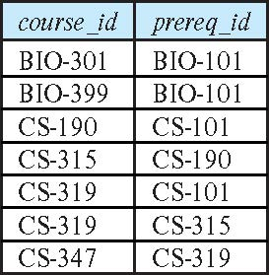
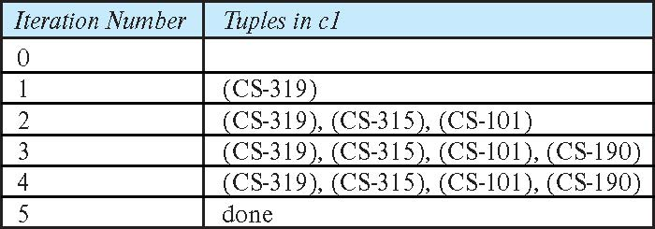
Example of Fixed-Point Computation
Computing transitive closure using iteration, adding successive tuples to rec_prereq
Each step of the iterative process constructs an extended version of rec_prereq from its recursive definition.
The final result is called the fixed point of the recursive view definition.

Slide 53
The Power of Recursion
Recursive views make it possible to write queries, such as transitive closure queries, that cannot be written without recursion or iteration.
Intuition: Without recursion, a non-recursive non-iterative program can perform only a fixed number of joins of prereq with itself. Obviously !!
This can give only a fixed number of levels of managers
Given a fixed non-recursive query, we can construct a database with a greater number of levels of prerequisites on which the query will not work
Alternative: write a procedure to iterate as many times as required
See procedure findAllPrereqs in book

Slide 54
The restriction on the recursive query
Recursive query part in the recursive views are required to be monotonic. That is, if we add tuples to prereq the view rec_prereq contains all of the tuples it contained before, plus possibly more
What makes the recursive query non-monotonic ?
Aggregation, not exist, set difference.

Slide 55
Advanced Aggregation Features Recommend to study
https://www.postgresqltutorial.com/
https://pgexercises.com/

Slide 56
Ranking
Ranking is done in conjunction with an order by specification.
Suppose we are given a relation student_grades(ID, GPA) giving the grade-point average of each student
Find the rank of each student.
select ID, rank() over (order by GPA desc) as s_rank from student_grades
An extra order by clause is needed to get them in sorted order
select ID, rank() over (order by GPA desc) as s_rank from student_grades order by s_rank
Ranking may leave gaps: e.g. if 2 students have the same top GPA, both have rank 1, and the next rank is 3
dense_rank does not leave gaps, so next dense rank would be 2
Thus it will result 1,1,2,
Notes:
56

Slide 57
Ranking
Ranking can be done using basic SQL aggregation, but resultant query is much more inefficient as opposed to system impl of rank
select ID, (1 + (select count(*) from student_grades B where B.GPA > A.GPA)) as s_rank from student_grades A order by s_rank;
Say we have 100 students, the smallest GPA results 99+1 rank value.

Slide 58
Ranking (Cont.)
Ranking can be done within partition of the data.
We have dept grades(ID,dept_name, GPA)
“Find the rank of students within each department.”
select ID, dept_name, rank () over (partition by dept_name order by GPA desc) as dept_rank from dept_grades order by dept_name, dept_rank;
Multiple rank clauses can occur in a single select clause.
F.e. We can obtain the overall rank and the rank within the department by using two rank operations in the same select clause.
Ranking is done after applying group by clause/aggregation
Ranking can be used to find top-n results
limit n clause supported by many databases with different meanings, moreover top-n within each partition is NOT possible with limit n operation
Ranking allows top-n within each partition
select *
from (select ID, rank() over (order by (GPA) desc) as s_rank from student_grades)
where s_rank <= 5;

Slide 59
Ranking (Cont.)
Other ranking functions:
percent_rank (within partition, if partitioning is done)
cume_dist (cumulative distribution)
fraction of tuples with preceding values
row_number (non-deterministic in presence of duplicates)
SQL:1999 permits the user to specify nulls first or nulls last
select ID, rank ( ) over (order by GPA desc nulls last) as s_rank from student_grades
Notes:
59

Slide 60
Ranking (Cont.)
For a given constant n, the ranking the function ntile(n) takes the tuples in each partition in the specified order, and divides them into n buckets with equal numbers of tuples as much as possible.
particularly useful for constructing histograms based on percentiles.
E.g.,
select ID, ntile(4) over (order by GPA desc) as quartile from student_grades;
We will have 4 buckets with equal sizes, i.e. different GPA ranges but with same num of tuples at each bucket.
Exercise::
https://www.postgresqltutorial.com/postgresql-window-function/postgresql-ntile-function/
Notes:
60

Slide 61
Windowing
Useful for trend analysis.
Used to smooth out random variations.:fluctuate widely from day to day, however, over a sufficiently long period of time, fluctuations might be less ! ( dont miss big picture)
E.g., moving average: “Given sales values for each date, calculate for each date the average of the sales on that day, the previous day, and the next day”
Window specification in SQL:
Given relation sales(date, value)
select date, sum(value) over (order by date between rows 1 preceding and 1 following) from sales
Not for a specific date. But whole dates..Not easy to write with classic SQL
Notes:
61

Slide 62
Windowing
Examples of other window specifications:
between rows unbounded preceding and current
rows unbounded preceding
range between 10 preceding and current row
All rows with values between current row value –10 to current value
range interval 10 day preceding
Not including current row
Notes:
62

Slide 63
Windowing (Cont.)
Can do windowing within partitions
E.g., Given a relation transaction (account_number, date_time, value), where value is positive for a deposit and negative for a withdrawal
“Find total balance of each account after each transaction on the account”
select account_number, date_time, sum (value) over (partition by account_number order by date_time rows unbounded preceding) as balance from transaction order by account_number, date_time
Notes:
63

Slide 64
OLAP

Slide 65
"Data Analysis" and OLAP
Online Analytical Processing (OLAP)
Interactive analysis of data, allowing data to be summarized and viewed in different ways in an online fashion (with negligible delay)
Common ops: Cross-tab (w/ pivoting), slicing, rollup, drilldown
Data that can be modeled as dimension attributes and measure attributes are called multidimensional data.
Measure attributes
measure some value
can be aggregated upon
e.g., the attribute number of the sales relation
Dimension attributes
define the dimensions on which measure attributes (or aggregates thereof) are viewed
e.g., attributes item_name, color, and size of the sales relation
We have a relation sales(item_name, color, clothes_size, quantity)
a shop wants to find out what kinds of clothes are popular.

Slide 66
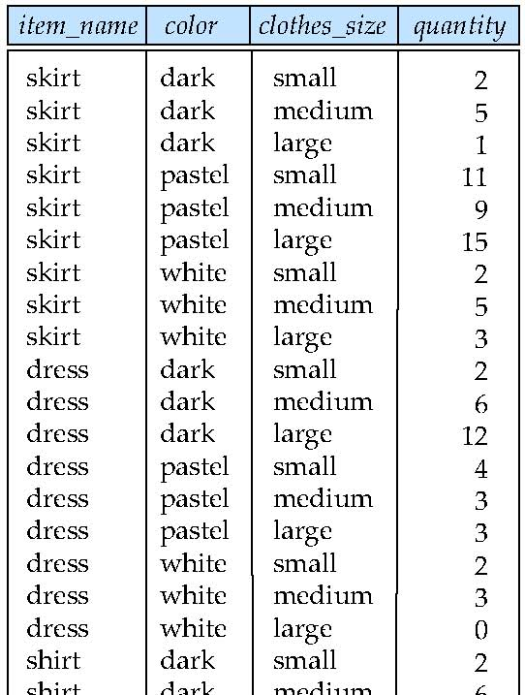
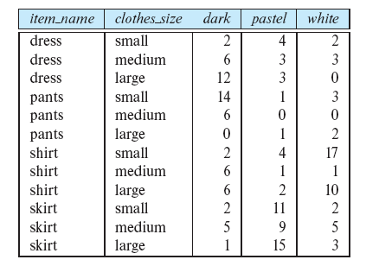



Example sales relation & pivoting
select *
from sales
pivot (
sum(quantity)
for color in
(’dark’,’pastel’, ’white’)
)
values
Values of pivot attr("color")
become attributes
...
...
...
...
...
...
...
...

Slide 67
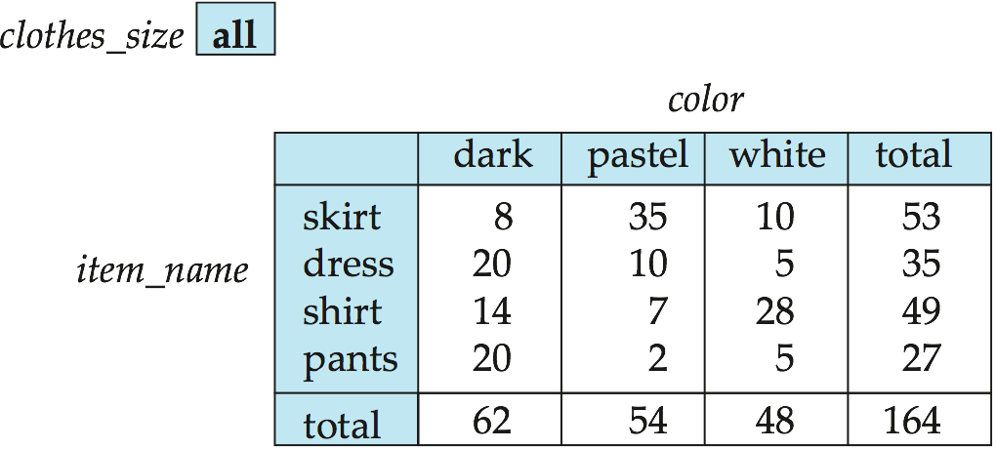
Cross Tabulation of sales by item_name and color
Pivot attr.
This is NOT relation.
The table above is an example of a cross-tabulation (cross-tab), also referred to as a pivot-table.
Values for one of the dimension attributes form the row headers
Values for another dimension attribute form the column headers
Other dimension attributes are listed on top --> pivot attribute(s)
Values in individual cells are (aggregates of) the values of the dimension attributes that specify the cell.
Do we infer "num of large skirts" from this table?

Slide 68
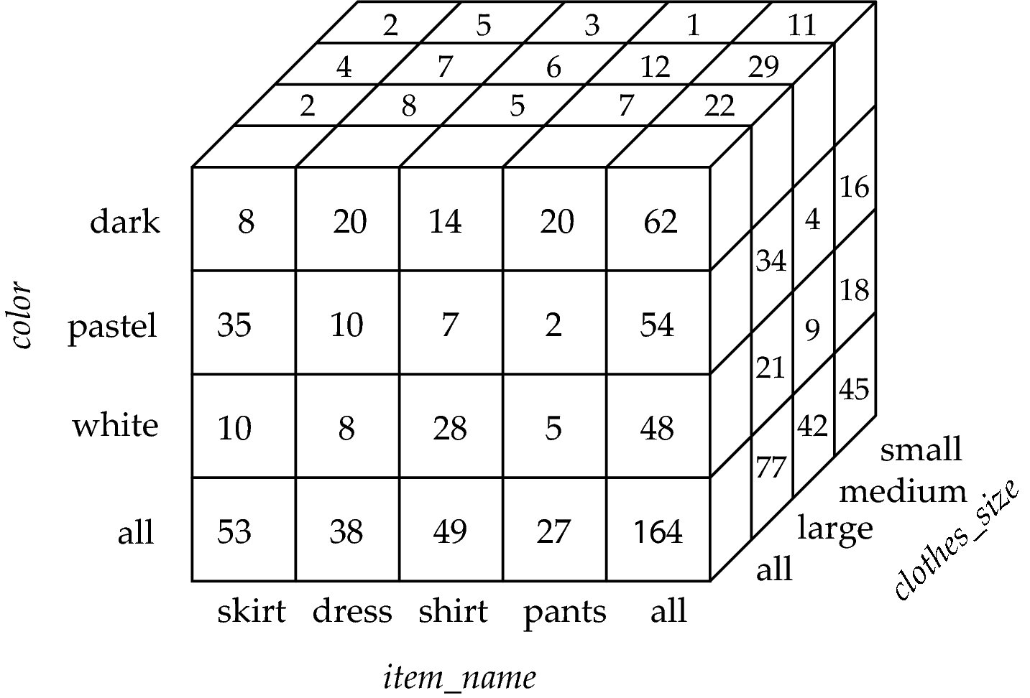



Data Cube
A data cube is a multidimensional generalization of a cross-tab
Can have n dimensions; we show 3 below
Cross-tabs can be used as views on a data cube
The size of a cube for n attributes A₁,...,A_{n} with cardinalities |A₁|,...,|A_{n}| is π|A_{i}|. This size increases exponentially with the number of attributes and linearly with the cardinalities of those attributes.
Total num of small-size dark skirts
Total num of ALL-size dark skirts
Each cell holds the agg_val (sum, avg..) that specific combination of values occurs together in the database.
Notes:
Sales relation has 4 items * 3 colors * 3 sizes = 36 cells.
The figure in this slide has 5*4*4 = 80 cells

Slide 69
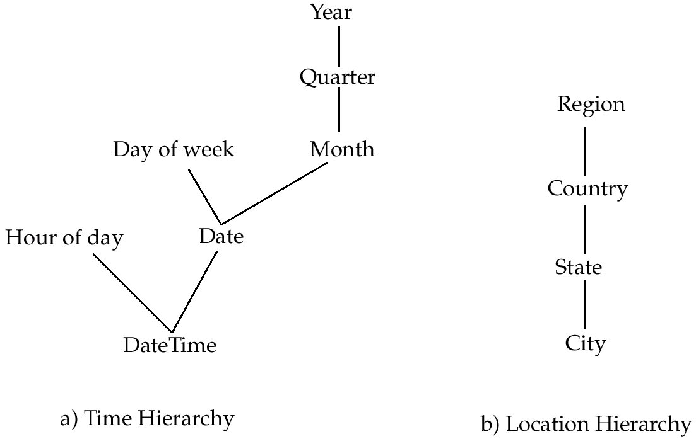
Hierarchies on Dimensions
Hierarchy on dimension attributes: lets dimensions to be viewed at different levels of detail
E.g., the dimension DateTime can be used to aggregate by hour of day, date, day of week, month, quarter or year
Notes:
sample DATE : 1999-01-08
sample TIME: 04:05:06
sample TIME followed by an optional time zone. : 04:05:06 PST
Sample TIMESTAMP: concatenation of a date and a time, followed by an optional time zone. January 8 04:05:06 1999 PST
Hierarchies are provided by a domain expert, because then the resulting general concepts will make sense to people familiar with the domain. Concept hierarchies might also be formed automatically by clustering.

Slide 70
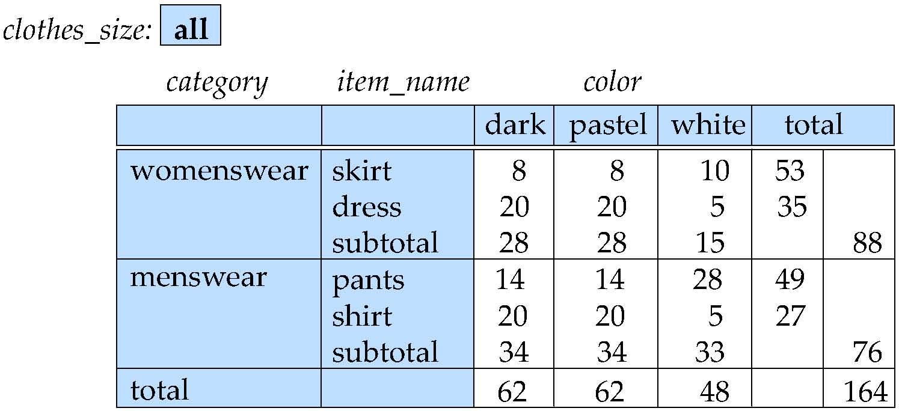
Cross Tabulation With Hierarchy
Cross-tabs can be easily extended to deal with hierarchies
Can drill down or roll up on a hierarchy

Slide 71
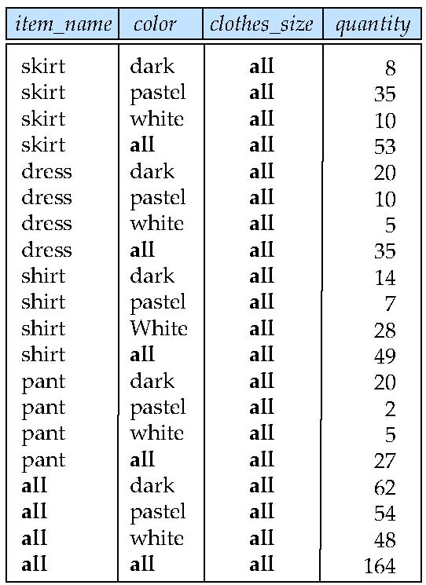
Relational Representation of Cross-tabs
Cross-tabs can be represented as relations
We use the value all is used to represent aggregates.
The SQL standard actually uses null values in place of all despite confusion with regular null values.

Slide 72
Extended Aggregation to Support OLAP
We need multiple group by queries to be run in a single query!
The cube operation computes union of group by’s on every subset of the specified attributes
Example relation for this section sales(item_name, color, clothes_size, quantity)
E.g., consider the query
select item_name, color, size, sum(number) from sales group by cube(item_name, color, size)
This computes the union of eight different groupings of the sales relation:
{ (item_name, color, size), (item_name, color), (item_name, size), (color, size), (item_name), (color), (size), ( ) }
where ( ) denotes an empty group by list.
For each grouping, the result contains the null value for attributes not present in the grouping.
Notes:
72

Slide 73
Online Analytical Processing Operations
Relational representation of cross-tab that we saw earlier, but with null in place of all, can be computed by
select item_name, color, sum(number) from sales group by cube(item_name, color)
restricted groupings, more controlled way.
S ..F. group by grouping sets ((color, clothes size), (clothes size, item name));
The function grouping() can be applied on an attribute
Returns 1 if the value is a null value representing all, and returns 0 in all other cases.
select item_name, color, size, sum(number), grouping(item_name) as item_name_flag, grouping(color) as color_flag, grouping(size) as size_flag, from sales group by cube(item_name, color, size)
Notes:
73
(case when grouping(item name) = 1 then ’all’
else item name end) as item name,

Slide 74
Online Analytical Processing Operations
Can use the function decode() in the select clause to replace such nulls by a value such as all
E.g., replace item_name in first query by decode( grouping(item_name), 1, ‘all’, item_name)
Notes:
74
DECODE is absent in PGSQL. May use CASE.

Slide 75
Extended Aggregation (Cont.)
The rollup construct generates union on every prefix of specified list of attributes including the empty prefix.
E.g., select item_name, color, size, sum(number) from sales group by rollup(item_name, color, size)
Generates union of four groupings:
{ (item_name, color, size), (item_name, color), (item_name), ( ) }
Rollup can be used to generate aggregates at multiple levels of a hierarchy.
E.g., suppose table itemcategory(item_name, category) gives the category of each item. Then
select category, item_name, sum(number) from sales, itemcategory where sales.item_name = itemcategory.item_name group by rollup(category, item_name)
would give a hierarchical summary by item_name and by category.
Notes:
75

Slide 76
Extended Aggregation (Cont.)
Multiple rollups and cubes can be used in a single group by clause
Each generates set of group by lists, cross product of sets gives overall set of group by lists
E.g.,
select item_name, color, size, sum(number) from sales group by rollup(item_name), rollup(color, size)
generates the groupings
{item_name, ()} X {(color, size), (color), ()}
= { (item_name, color, size), (item_name, color), (item_name), (color, size), (color), ( ) }
Notes:
76

Slide 77
Online Analytical Processing Operations
Pivoting: changing the dimensions used in a cross-tab is called
Slicing: creating a cross-tab for fixed values only
Sometimes called dicing, particularly when values for multiple dimensions are fixed.
Rollup: moving from finer-granularity data to a coarser granularity = Rollup or summarization of the data cube, can be done by traversing upwards
Drill down: The opposite operation - that of moving from coarser-granularity data to finer-granularity data
Study the test case for rollup & drill down @ following::: http://www2.cs.uregina.ca/~dbd/cs831/notes/dcubes/dcubes.html
https://www.javatpoint.com/olap-operations

Slide 78
OLAP Implementation
The earliest OLAP systems used multidimensional arrays in memory to store data cubes, and are referred to as multidimensional OLAP (MOLAP) systems.
OLAP implementations using only relational database features are called relational OLAP (ROLAP) systems
Hybrid systems, which store some summaries in memory and store the base data and other summaries in a relational database, are called hybrid OLAP (HOLAP) systems.

Slide 79
OLAP Implementation (Cont.)
Early OLAP systems precomputed all possible aggregates in order to provide online response
Space and time requirements for doing so can be very high
2^{n} combinations of group by
It suffices to precompute some aggregates, and compute others on demand from one of the precomputed aggregates
Can compute aggregate on (item_name, color) from an aggregate on (item_name, color, size)
For all but a few “non-decomposable” aggregates such as median is cheaper than computing it from scratch
Several optimizations available for computing multiple aggregates
Can compute aggregate on (item_name, color) from an aggregate on (item_name, color, size)
Can compute aggregates on (item_name, color, size), (item_name, color) and (item_name) using a single sorting of the base data

Slide 80
End of Chapter 5

